Slide 1
Image Segmentation
Computer Vision

Slide 2
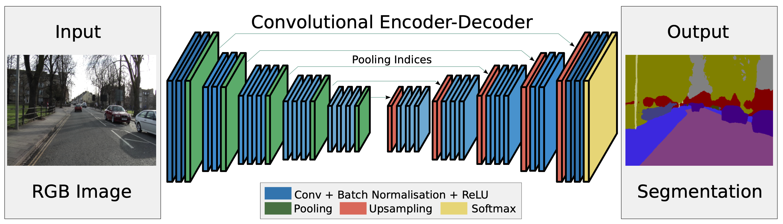
SegNet – From the Lecture
Notes:
The second task concers with implementing a simplied version of SegNet which was introduced in the lecture.

Slide 3
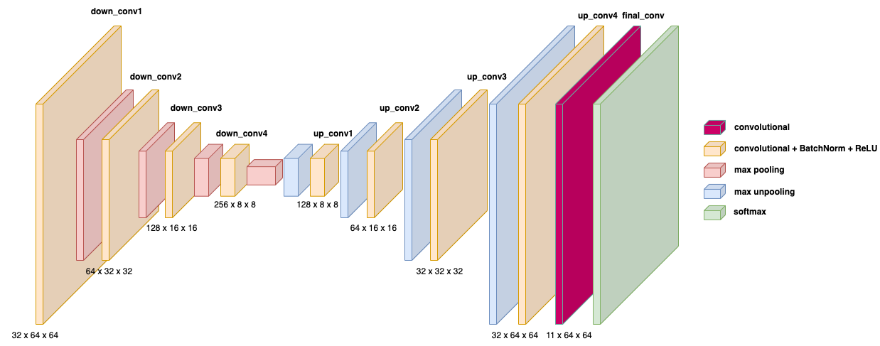
SegNet – Simplified Version
Notes:
For this simplified version, we will have one convolution per block instead of multiple convolutions. The numbers in this slide indicate dimensions of output tensor of each convolution layer.

Slide 4
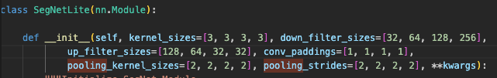
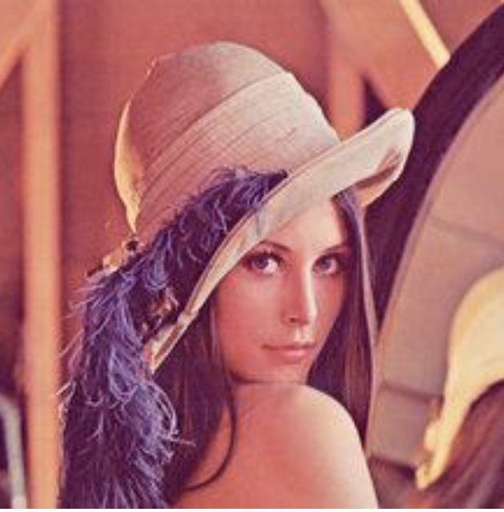
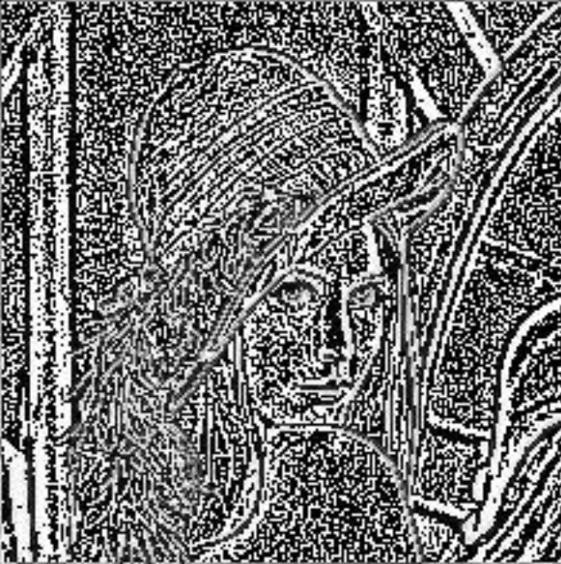
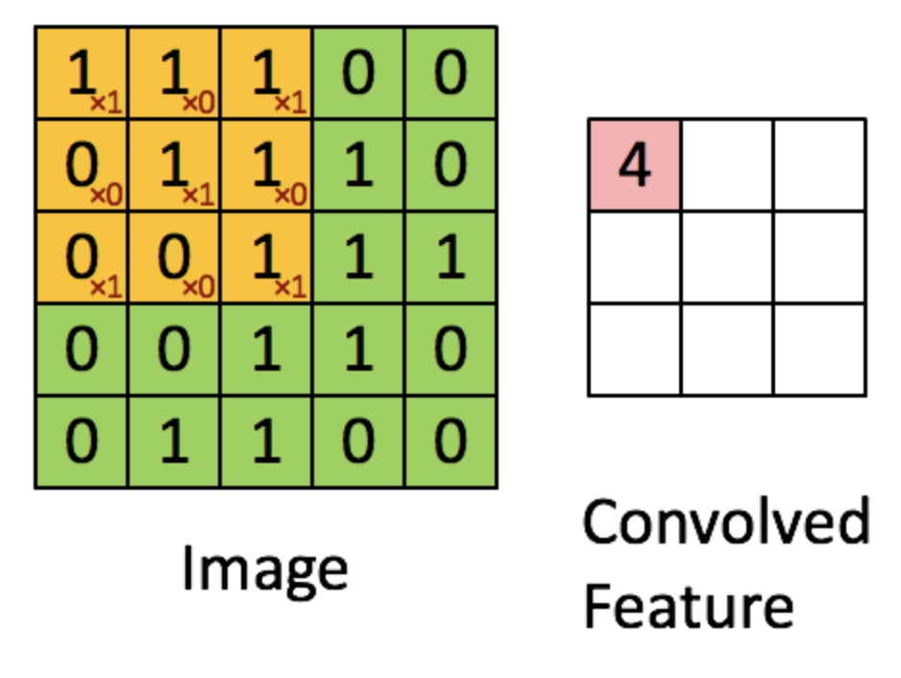
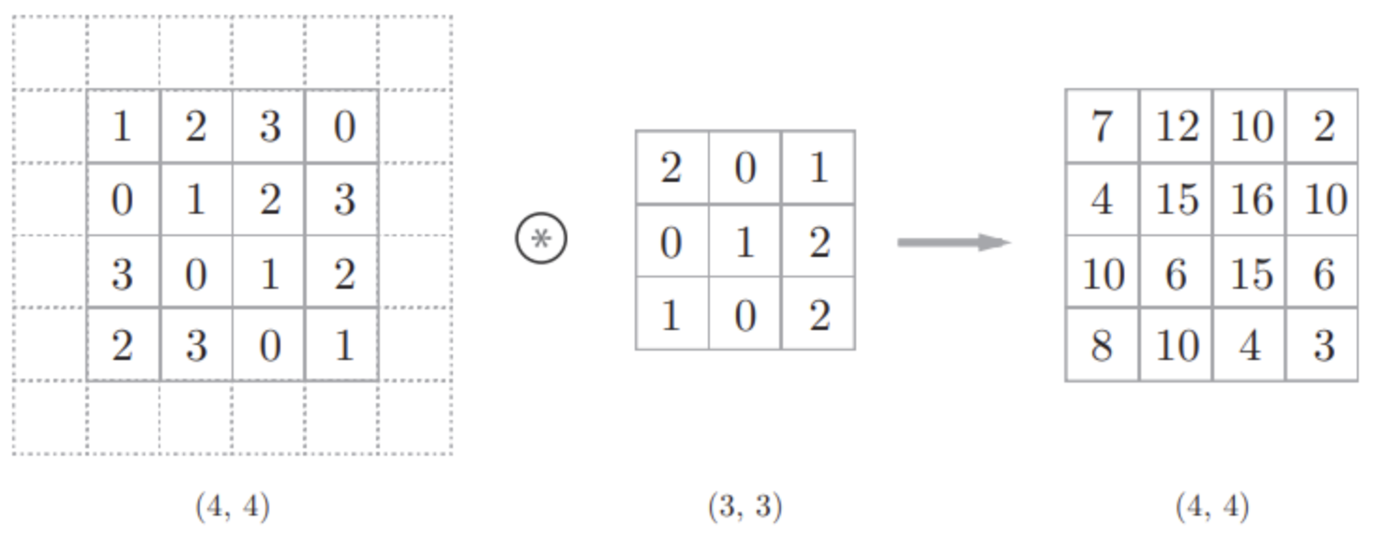
Basic Modules
Conv2d,
BatchNorm2d,
MaxPool2d
MaxUnpool2d
Conv pooling
https://zhuanlan.zhihu.com/p/76606892
https://blog.csdn.net/dongjinkun/article/details/117949042
Notes:
The modules you need to build this network include Conv2d, BatchNorm2d, MaxPool2d and MaxUnpool2d. Since you already learned about Conv2d and MaxPool2d in the last assignment, we will skip them here and talk about the other two modules.

Slide 5
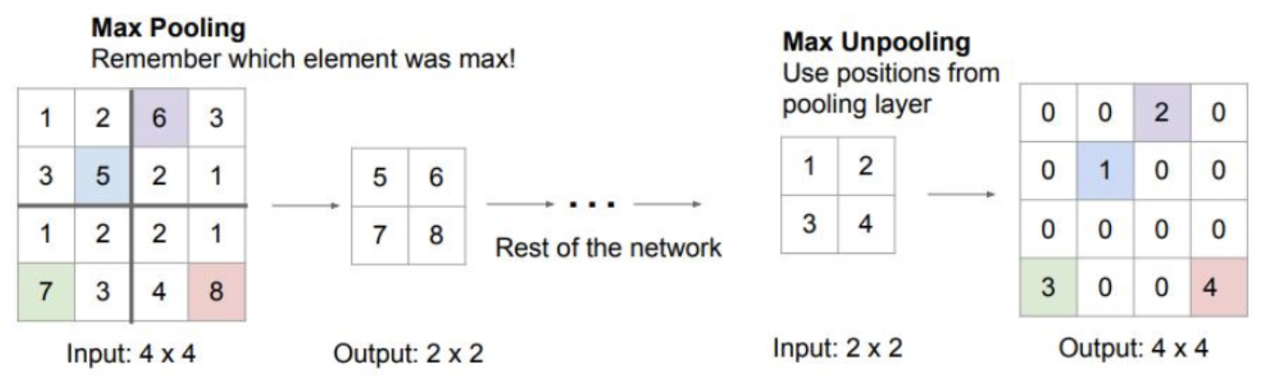
Basic Modules
Conv2d,
BatchNorm2d,
MaxPool2d
MaxUnpool2d
Max pooling Max Unpooling
https://blog.csdn.net/hxxjxw/article/details/122911334
Notes:
The modules you need to build this network include Conv2d, BatchNorm2d, MaxPool2d and MaxUnpool2d. Since you already learned about Conv2d and MaxPool2d in the last assignment, we will skip them here and talk about the other two modules.

Slide 6
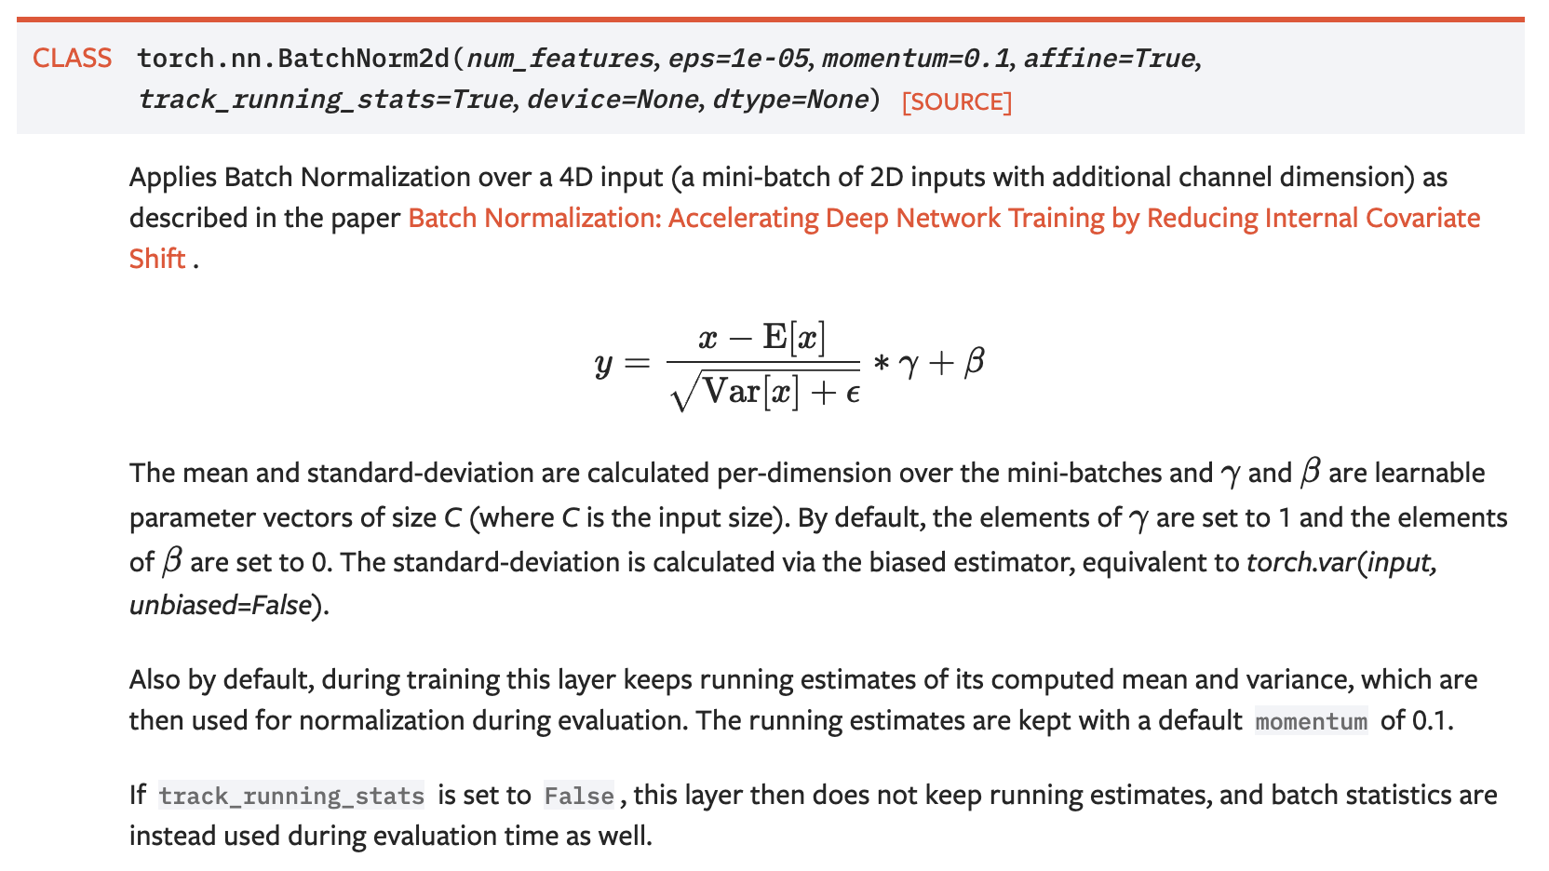
Basic Modules – BatchNorm2d
https://pytorch.org/docs/stable/generated/torch.nn.BatchNorm2d.html
Notes:
BatchNorm layer aims to normalize the outputs of a certain layer. In this way it can make the training process converge faster while also generalize better. Here in the equation, E and V represents mean and variance computed per-minibatch, while gamma and beta constitutes a learnable affine transformation. By default, the Batchnorm layer maintains running mean and variance internally and update them with a momentum during training, while at testing it fixes these running mean and variance and use them for normalizatoin. Usually you don’t need to change the default hyperparameters of this Module.

Slide 7
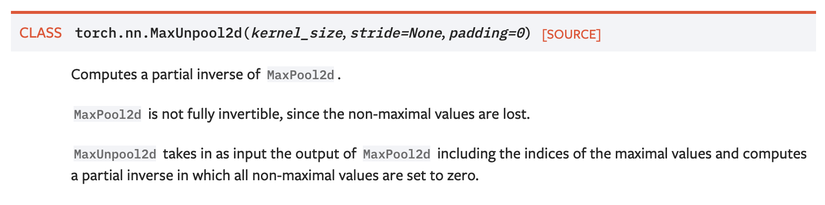
Basic Modules – MaxUnpool2d
https://pytorch.org/docs/stable/generated/torch.nn.MaxUnpool2d.html
Notes:
MaxUnpooling was introduced in the lecture. Basically it takes the outputs of MaxPooling layer as inputs, including network activations and max indices. The output would be an unsampled tensor, with max values from max-pooling perserved while other non-max values setting to 0.

Slide 8
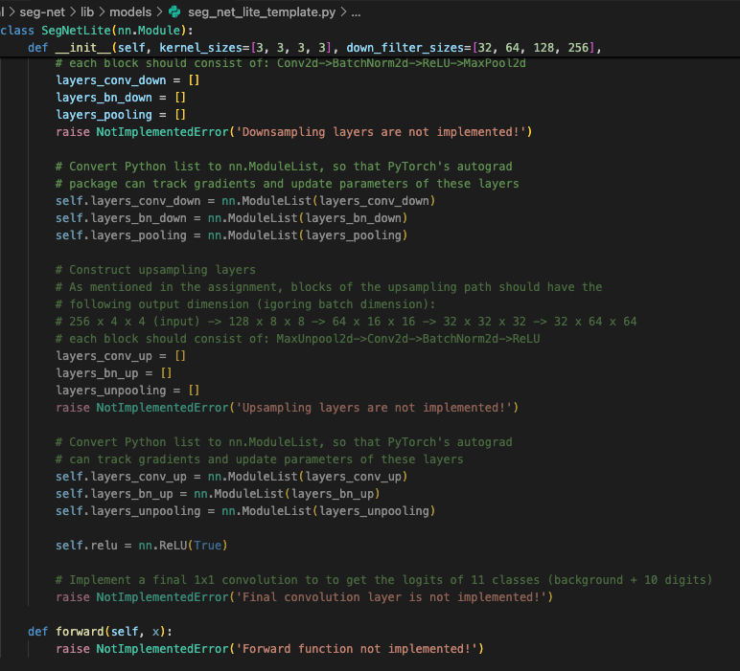
TODO

Slide 9
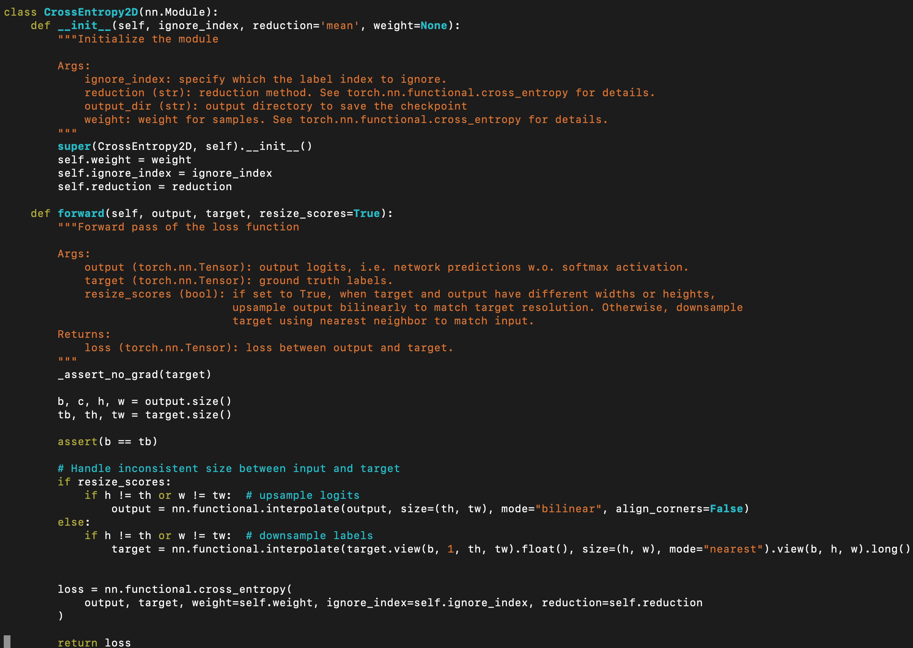
Loss – Per-pixel Cross-Entropy Loss
Notes:
Semantic segmentation is essentially a per-pixel classification problem, so you can just apply element-wise cross_entropy loss on your network’s output. Note that in PyTorch, the input to cross_entropy function should be unnormalized (i.e. without applying softmax).

Slide 10
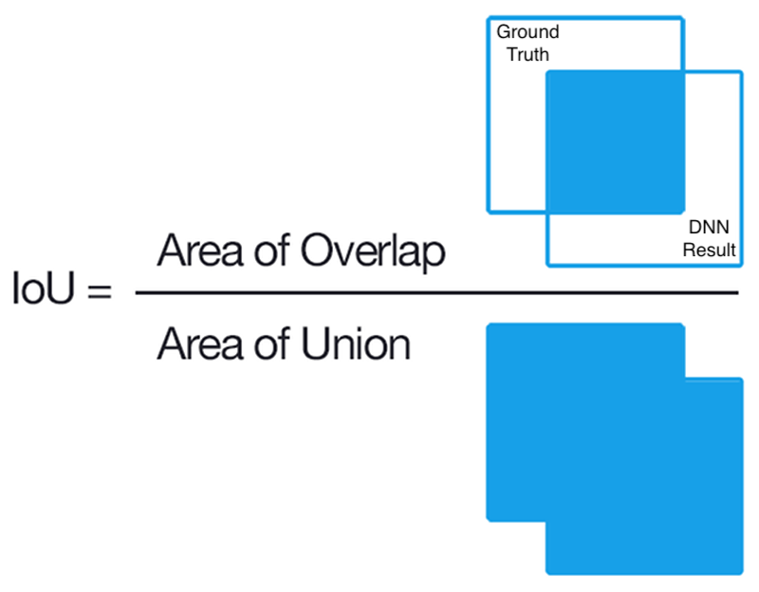
Evaluation Metric – Intersection Over Union
Notes:
To evaluation the semantic segmentation, we use the intersection over union metric, or IoU. Given the ground-truth mask and your predicted mask, IoU literally computes the value of the intersection of the two masks over the union of the two masks.

Slide 11


SegNet
Dataset – multi-digit MNIST
Input Image (64x64)
GT Labels
Notes:
You will be working on multi-digit MNIST dataset, in which hand-written numbers are placed randomly and you need classify for each pixel whether it belongs to one of the digits or to the background. So the number of classes would be 10 digits plus the background class.

Slide 12
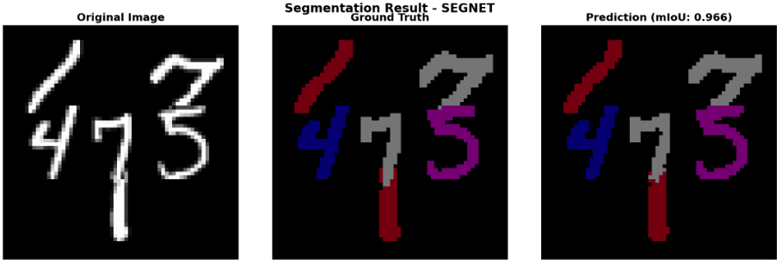
Visualization
Notes:
# python visualize_simple.py \
# --model segnet \
# --checkpoint out/checkpoint.pth.tar \
# --data data/multi-digit-mnist/testset001.mat \
# --save segnet_result.png

